Slide 1
AMAZON SALES
DATA ANALYSIS REPORT
ATHUL JOHNSON

Slide 2
Problem Statement
Objective
Benefits
Help out to make better business decisions.
Help analyze customer trends and satisfaction, which can lead to new and better products and services.
Gives better insight of customers base.
Helps in easy flow for managing resources.
Sales management has gained importance to meet increasing competition and the need
for improved methods of distribution to reduce cost and to increase profits. Sales
management today is the most important function in a commercial and business
enterprise.
Develop a Report by Extracting-Transforming-Loading of data which contains Sales trend with respect to Year, Month, Quarter and find Some relationships through data to understand and Analyze the Facts.

Slide 3
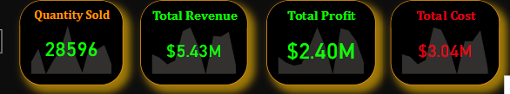
Quick Insight
﻿A quick insight for 2010-2017 amazon sales.

Slide 4
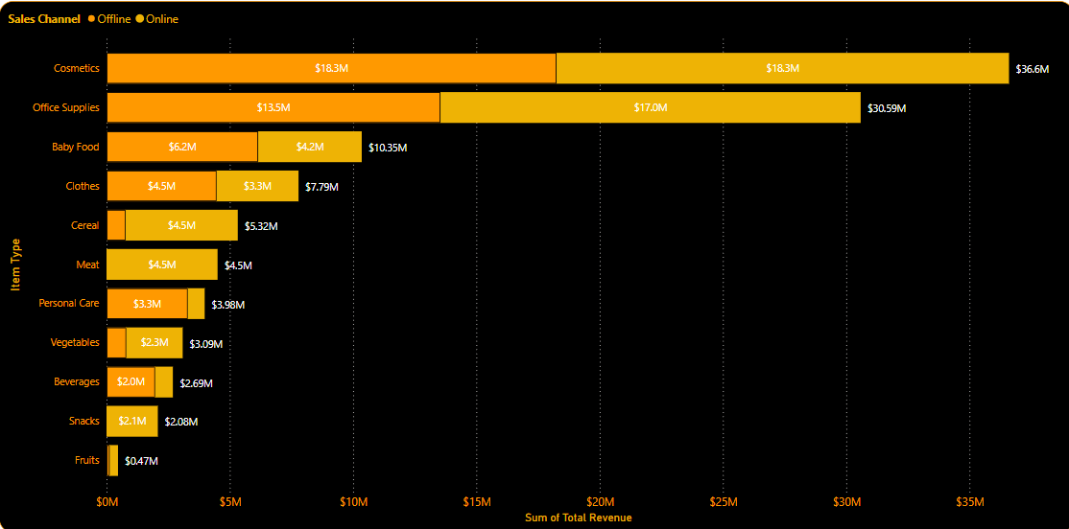
Total Revenue by Item Type and Sales Channel
﻿The Highest Revenue is Generated by Cosmetics of 36.3 M﻿

Slide 5
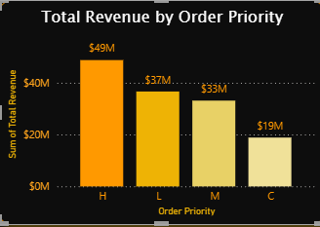
Total Revenue by Order Priority
The highest Revenue is Generated from the Higher Priority of 49M and the least by the Couldn,t Wait of 19 M

Slide 6
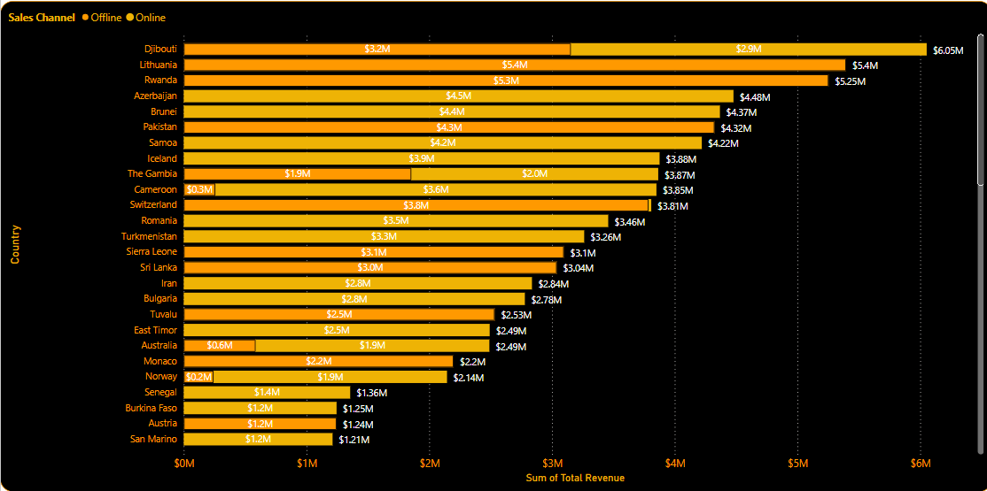
Revenue Categorized By Countries
﻿from Djibouti the revenue is 6.05M followed by Lithuania and Lowest from Kuwait

Slide 7
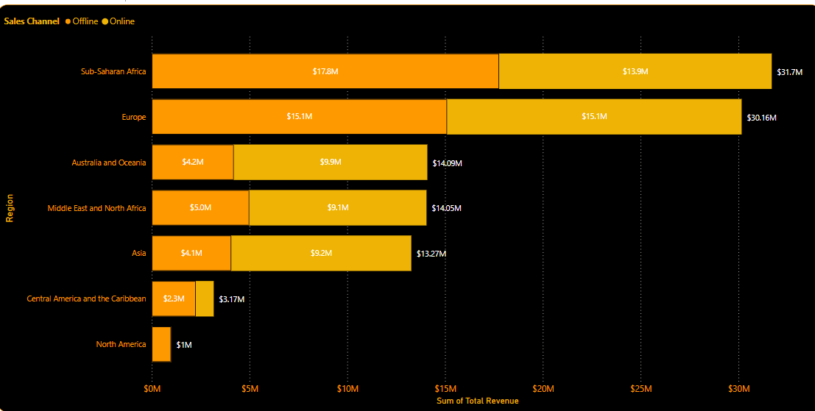
Revenue from Regions
Sub-Saharan Africa Generated high Revenue of 31.7M followed by Europe

Slide 8
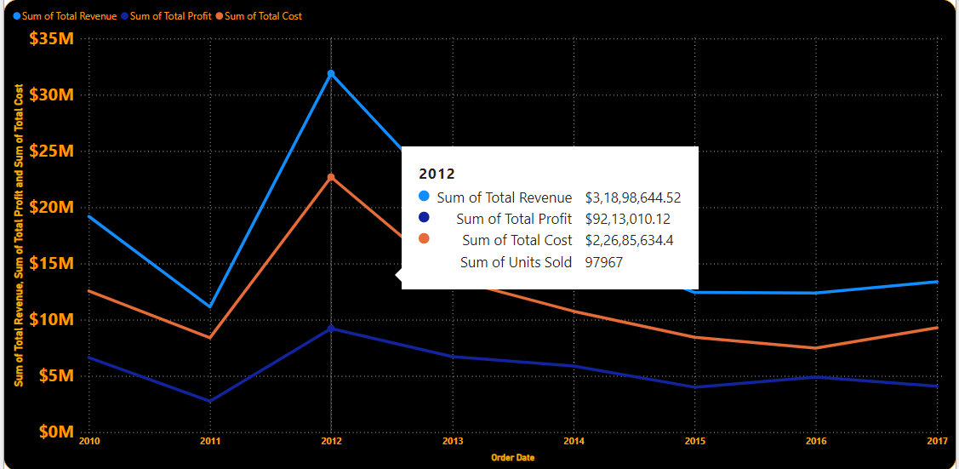
Revenue ,Profit ,Cost by year
2012 is the year with highest Revenue, Profit and cost

Slide 9
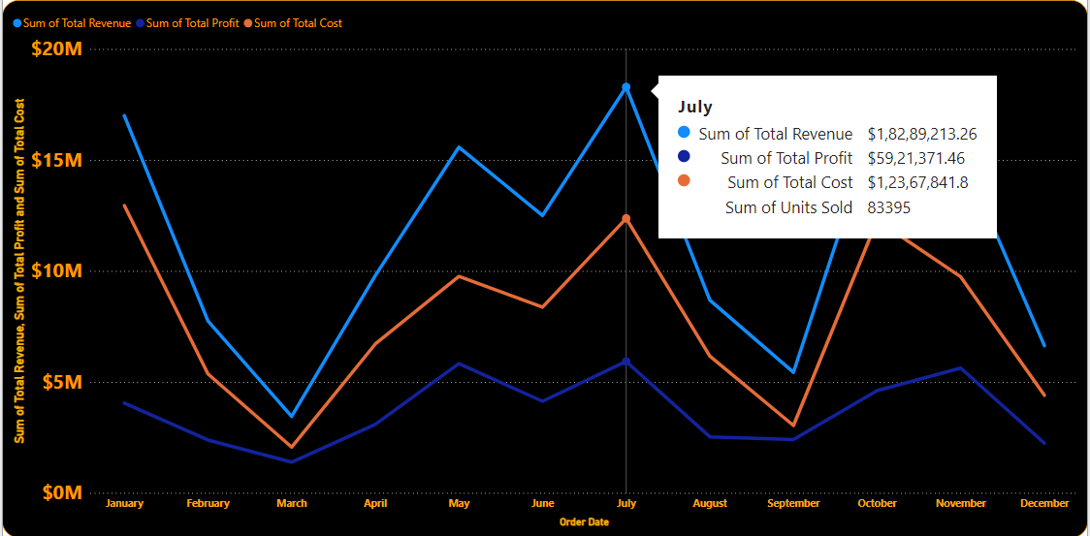
Top Month with High Revenue, Profit,Cost
July is the Top Revenue, Profit, Cost month

Slide 10
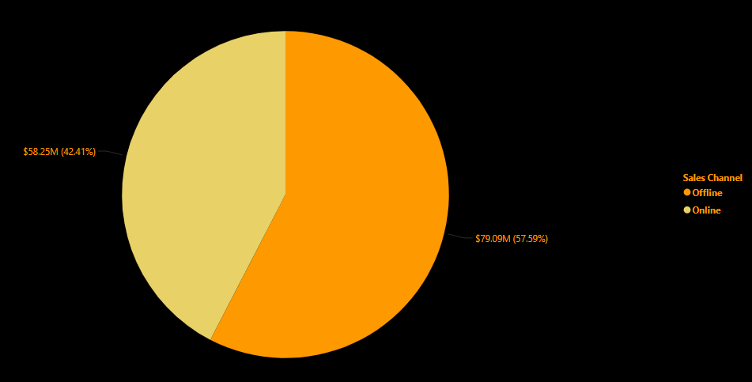
Revenue by Sales Channel
Through Offline the Most sales take placed 79.09M(57.59%)

Slide 11
Conclusion
1. The Highest Revenue is Generated by Cosmetics of 36.3 M﻿ followed by Office Supplies of 30.59 M
2. The highest Revenue is Generated from the Higher Priority of 49M and the least by the Couldn’t Wait of 19 M
3. ﻿from Djibouti the revenue is 6.05M followed by Lithuania and Lowest from Kuwait
4. Sub-Saharan Africa Generated a high Revenue of 31.7M followed by Europe
5. 2012 is the year and July is the Month with a highest Revenue, Profit, and cost
6. Through Offline the Most sales take placed 79.09M(57.59%) and through Online 58.25M(42.25%)

